Slide 1




NEXT GEN EMPLOYABILITY PROGRAM
Creating a future-ready workforce
Team Members
College Name
Student Name : S. Giri Sankar
Student ID : au813121104014
Pavendar Bharathidasan College of Engineering and Technology
Notes:
1

Slide 2

CAPSTONE PROJECT SHOWCASE
Project Title
Car Rentals Application with Django Framework
Abstract | Problem Statement | Project Overview | Proposed Solution | Technology Used | Modelling & Results | Conclusion

Slide 3
Abstract “CAR RENTAL APPLICATION WITH DJANGO FRAMEWORK” is a project which aims in developing an Online Application of car rental system. It is a system that enables customer to rent a car to place their choice online at any time at any place. The reason to develop the system is due to the issues of facing by fuel cost. These issues are such as peak hour-long queue issues, increase of taxi and private cabs than visitors, speed major request of car management, limited promotion, and quality control of cars management. Therefore this system enhances the speed and standardization pf taking rental car from the customers and display it to the staff in the website accordingly. Beside that it provide user friendly web-pages and effective advertising medium to the new product of the online car rental system to the customer at reasonable price. Furthermore, it also extend and deliver customer satisfactions especially to the hectic customer or reaching the customers who are constrain of transport to be in car shop. Altogether it is helpful for everyone for the customers and for the traveler’s also.
Source : arkajainuniversity.ac.in

Slide 4
Problem Statement The Manual car rental system provides services only during office hours. So; customers have limited time to make any transactions or reservation of the cars. The existence of the online car rental systems nowadays has overcome the limitation of the business operation hour. However; there is still a few numbers of these online car rental systems in Malaysia and most of the systems offered reservation service for tourists or traveler. Besides that, there are some customers who faced a problem in choosing car to be rented which suitable with some of the important requirements. 1. To rent a car a prospective renter must first go to the nearest office to register as a client. 2. Cars that provide difficulties to rent out are normally advertised in local or national newspaper. it involves a lot of paper work and consumes time.
Source : www.coursehero.com

Slide 5
Project Overview The primary purpose of an online car rental system is to allow customers to easily do order at website over the internet. With the improvement of technology, online car rental systems are becoming a popular topic. That’s because they are serving the ever-increasing Demand for convince. It benefits both the customer and the business. With a website or mobile app, customers can easily Browse all the dishes and place order of their favourite one. From the car rental perspective, they no longer spend time taking the customer’s order, stop worrying about communication errors and streamline their order management workflow. The main purpose behind building this website is to establish A smooth and easy way of ordering process to the users so they Didn’t get any trouble in placing orders or cancelling orders. In this project everything has been made in synchronize way with full order and sequence admin has full control over the system. And user will get a lot of facilities in this system.
Source : arkajainuniversity.ac.in

Slide 6
Proposed Solution
The existing system is a manual one. After studying the problems of the existing system, the following requirements have been identified.
Develop a new system that will reduce the manual effort of creating reports
Develop a system that will built-up the database to facilitate future information and retrieval for analysis and other statements.
Develop a system that will automate the monitoring of any problem During Analysis.
Develop a system that has a flexible form design.
The system should have provision to view performance during working with system After completing the requirement determination and doing re analysis a new system is designed which could solve the problem of existing system and fulfill the requirement of the users.
Source :

Slide 7
The benefits of the “Designing Training Database & Effectiveness” are as follows:- • Quick and easy retrieval of information • Low cost maintenance. • The system is not person dependent. • Knowledge of computer skill required is minimum. • Use of this system will automate the function. • It will also lead this system to improve the quality
Source :

Slide 8
This Car Rental System project will enable the user to rent a vehicle. The user shall login to the system and check for availability of cars. The user specifies a type of car and the journey date and time. The Car Rental System shall check for the availability of the car and rent the car to the customer. The user can make payment online. The tool is designed using VB.net. All the data regarding the rental cars are stored in MySQL database. The user has to enter his name, address, phone details and check for the cars available for rent. The UI is very simple and the connectivity to back end is robust. The main advantage is that the user shall be able to choose a car depending on his budget.
Source :

Slide 9


Technology Used
Front-end
Back-end
Source :

Slide 10
Modelling & Results This project traverses a lot of areas ranging from business concept to computing field, and required to perform several researches to be able to achieve the project objectives. The area covers include: Car rental industry: This includes study on how the car rental business is being done, process involved and opportunity that exist for improvement. General customers as well as the company’s staff will be able to use the system effectively. Web-platform means that the system will be available for access 24/7 except when there is a temporary server issue which is expected to be minimal. The system hasre acheda steady state where all bugs have been eliminated. The system is operated at a high level of efficiency and all teachers and users associated with the system understand its advantage. The system solves the problem- it was intended to solve as requirement specification. The system is user friendly & easy to maintain.
Source :

Slide 11
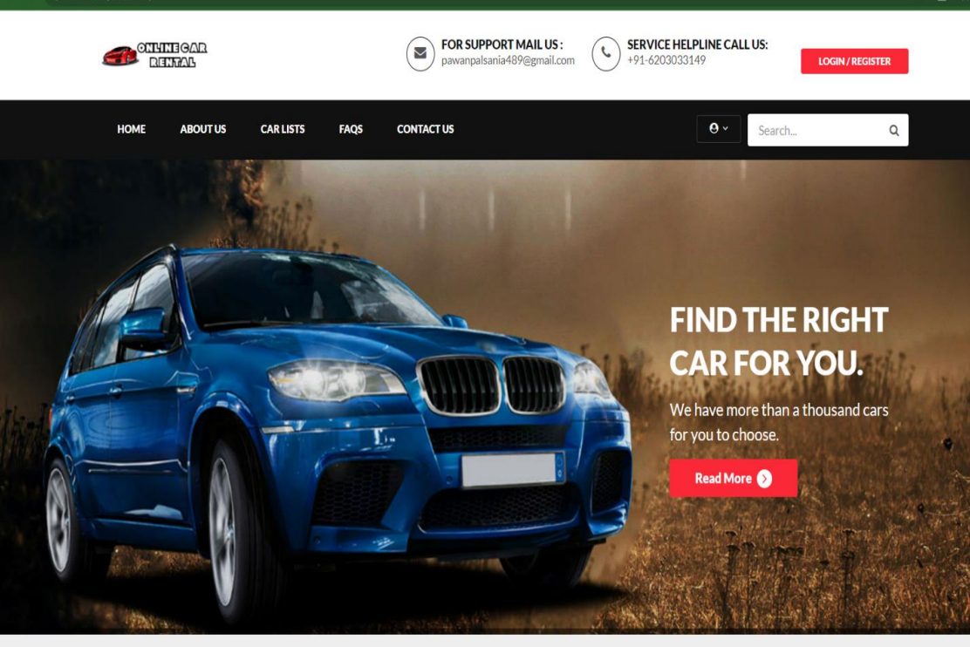
Homepage

Slide 12
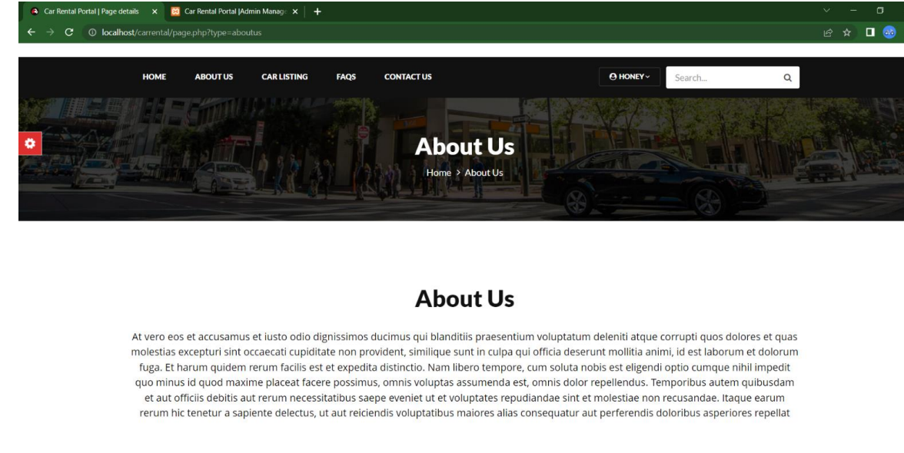
About-Us-Page

Slide 13
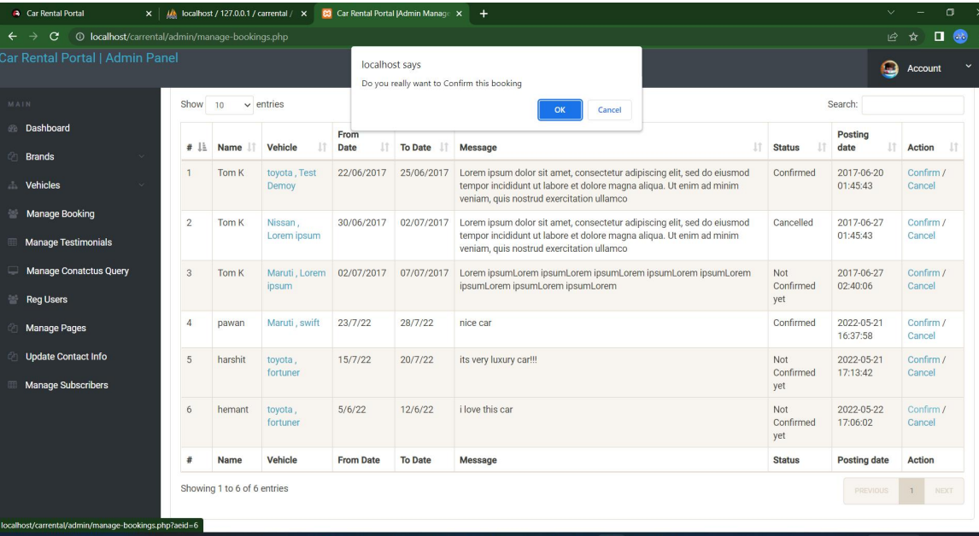
Service-Page

Slide 14
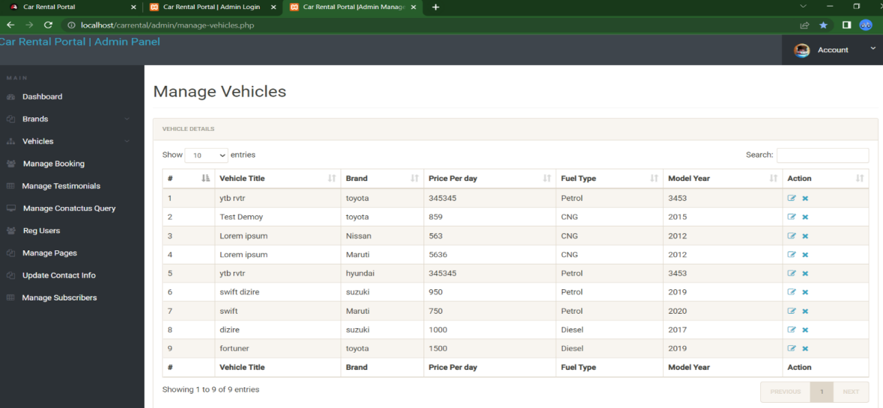
Departments-Page

Slide 15
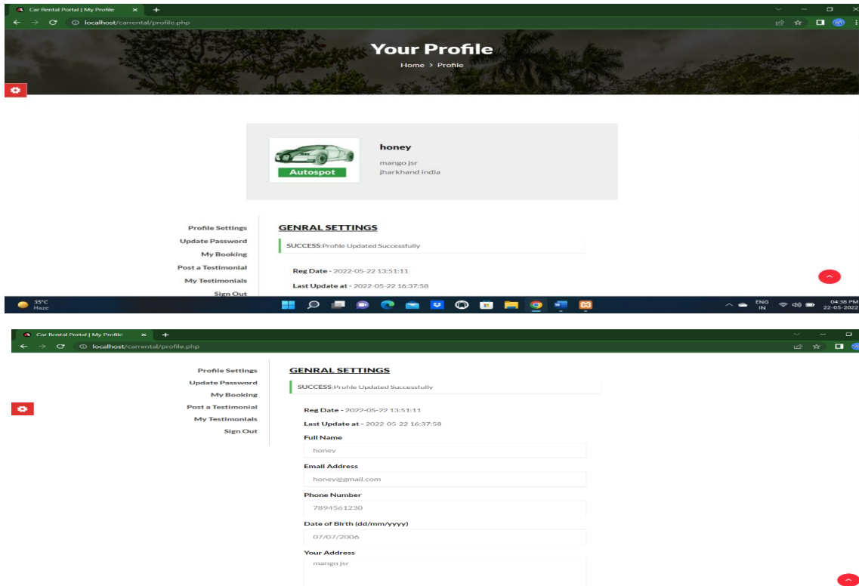
Blog-Page

Slide 16
Future Enhancements: This order cars online system project aimed at developing an online car rental system which can be used in small places, and medium cities firstly and then on a large scale. ▪ It is developed to help car rental to simplify their daily operational and managerial task as well as improve the dining experience of customers. ▪ And also helps restaurant develop healthy customer relationships by providing good services. The system enables staff to let update and make changes to their cars and beverage list information based on the orders placed and the orders completed.

Slide 17
Conclusion An CAR RENTAL APPLICATION is developed where the customers can make an order for the cars and avoid the hassles of waiting for the order to be taken by the waiter. Using the application, the end users register online, read the E-menu card and select the cars from the e-menu card to order cars online. Once the customer selects the required cars item the chef will be able to see the results on the screen and start processing the cars. This application nullifies the need of a waiter or reduces the workload of the waiter.The advantage is that in a crowded restaurant there will be chances that the waiters are overloaded with orders and they are unable to meet the requirements of the customer in a satisfactory manner. Therefore by using this application, the users can directly place the order for cars to the chef online. In conclusion an online car rental system is proposed which is useful in small family run car rental as well as in places like college cafeteria, etc. This project can later be expanded on a larger scale. It is developed for car rentalto simplify their routine managerial and operational task and to improve the dining experience of the clients.This also helps the restaurant owners develop healthy customer relationships by providing reasonably good services. The system also enables the restaurant to know the items available in real time and make changes to their cars and beverage inventory based on the orders placed and the orders completed.
Source : arkajainuniversity.ac.in

Slide 18
Thank You!
Notes:
Thank You !!

